Slide 1

QRYPTO
EDUCATION CASE STUDY
Cutting Edge Document Security made simple

Slide 2






CONTENTS
Introduction
Challenge & Problems
Key Decision Factors
Technology Choice
Solution & Verification Experience

Slide 3


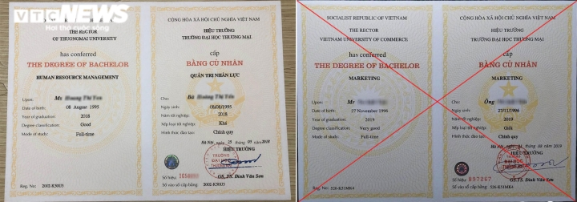
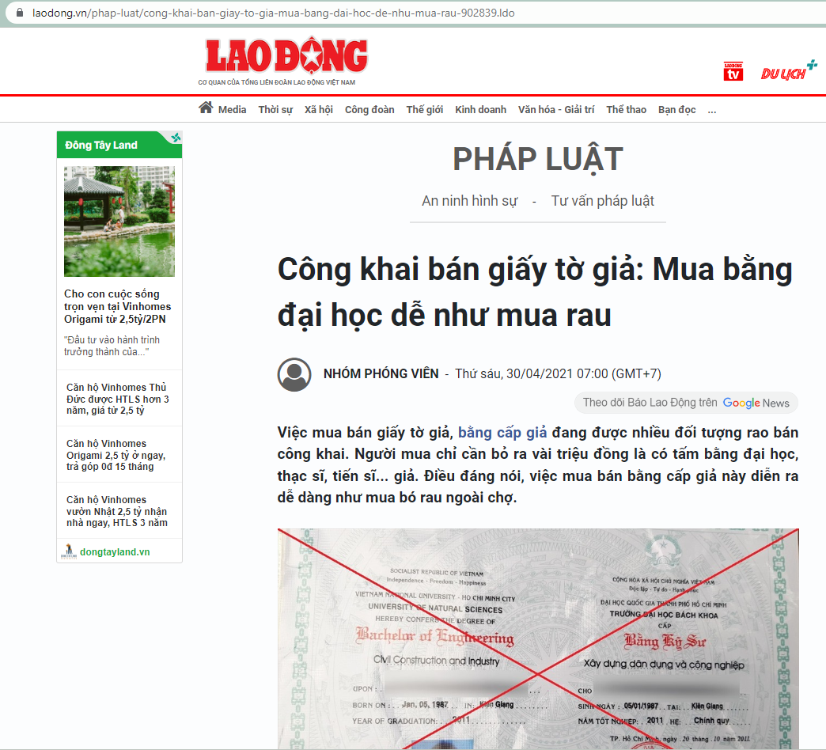
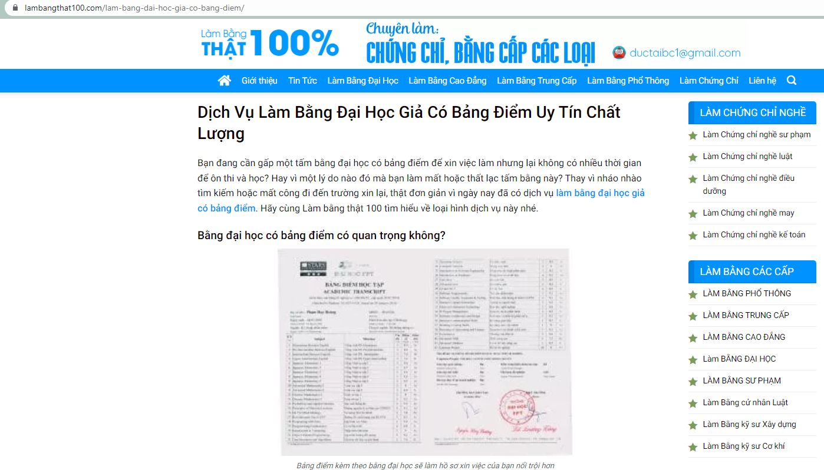
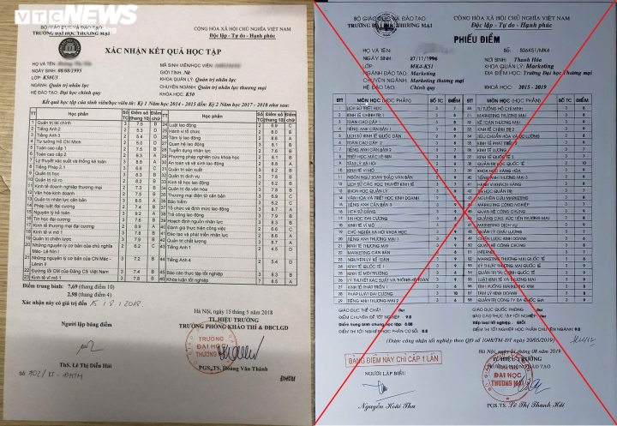
About
QR-code
A method of verifying the authenticity and integrity of physical documents.
Use cryptography to create a unique digitally signed QR code tied to the document and the issuer.
This code can be scanned by a third party to confirm that the document is valid and has not been tampered with.
INTRODUCTION
The service of making transcripts, fake university degrees, colleges is more and more
FAKE
Delivers highly secure and easily verifiable transcripts and certificates to students in electronic and printed formats

Slide 4



Challenges
Problems
Fake degrees and transcripts are becoming more and more widespread, sophisticated, and difficult to verify
Educational certificates and transcripts play a critical role in a person’s life and career
Implement the best systems to make their certificates and transcripts tamper-proof and unforgeable in both formats digital and physical
Verification of educational credentials, traditionally one or more of the following approaches are used:
1
2
3
4
Provide a valuable service to students by making credentials instantly verifiable by third parties like other universities, embassy visa officers and employers
Clearing house
Third party
verification service providers
Direct approach
Physical Security Features

Slide 5
1
2
3
4
Clearing house
Third party
verification service providers
Direct approach
Physical Security Features
Universities tie-up with clearing houses which provide verifiers with access to the information for a fee

Slide 6
2
1
3
4
Third party
verification service providers
Clearing house
Direct approach
Physical Security Features
Background verification companies/employment screening intermediaries approach the educational institution through their established channels and get the details for the specific student(s) verified for a specific client.

Slide 7
3
1
2
4
Direct approach
Clearing house
Third party
verification service providers
The verifier may directly contact the University through channels such as e-mail or online account to get details which are provided after ascertaining the need for giving the information
Physical Security Features

Slide 8
4
1
2
3
Physical Security Features
Clearing house
Third party
verification service providers
Direct approach
Holograms, RFID tags etc. are sometimes used but these fall short on many fronts:
Ease of verification
Can by their nature only work for originals and not for copies or electronic versions
Short shelf-life

Slide 9
Challenges
Problems
Fake degrees and transcripts are becoming more and more widespread, sophisticated, and difficult to verify
Educational certificates and transcripts play a critical role in a person’s life and career
Implement the best systems to make their certificates and transcripts tamper-proof and unforgeable in both formats digital and physical
Verification of educational credentials, traditionally one or more of the following approaches are used:
1
2
3
4
Provide a valuable service to students by making credentials instantly verifiable by third parties like other universities, embassy visa officers and employers
Clearing house
Third party
verification service providers
Direct approach
Physical Security Features
Time is taken for verification, cost, the possibility of manipulation of low scrutiny databases, connivance of staff to give wrong information and exposes sensitive student information to these “intermediate handlers”

Slide 10






KEY DECISION FACTORS
The seamless security offered across both digital and physical formats.
To be easy to generate and yet be tamper proof with a high level of security
Many different types of solutions: Holograms, embossments, digital, RFID and smart chips, QR code – that are available
Affordable cost
A simple implementation methodology
Seamless Security
Digital & Physical
Tamper Proof
Easy Generation
Affordable Integration and Implementation
Ease of Verification

Slide 11


Easy API integration with University’s Student Information System (SIS)
Integrated support for both secure code and document generation based on university’s template layouts
TECHNOLOGY CHOICE
Reasons for using QR-Code
Security for both digital and physical printed certificate formats
Responsive support
Multi-user and audit trails

Slide 12
TECHNOLOGY CHOICE
Integrated support for both secure code and document generation based on university’s template layouts
Easy API integration with University’s Student Information System (SIS)
Reasons for using QR-Code
Security for both digital and physical printed certificate formats
Multi-user and audit trails
Responsive support

Slide 13
Easy API integration with University’s Student Information System (SIS)
TECHNOLOGY CHOICE
Integrated support for both secure code and document generation based on university’s template layouts
Reasons for using QR-Code
Security for both digital and physical printed certificate formats
Responsive support
Multi-user and audit trails

Slide 14
Easy API integration with University’s Student Information System (SIS)
Integrated support for both secure code and document generation based on university’s template layouts
TECHNOLOGY CHOICE
Reasons for using QR-Code
Security for both digital and physical printed certificate formats
Multi-user and audit trails
Responsive support

Slide 15
Integrated support for both secure code and document generation based on university’s template layouts
TECHNOLOGY CHOICE
Easy API integration with University’s Student Information System (SIS)
Reasons for using QR-Code
Security for both digital and physical printed certificate formats
Multi-user and audit trails
Responsive support

Slide 16
TECHNOLOGY CHOICE
Easy API integration with University’s Student Information System (SIS)
Reasons for using QR-Code
Integrated support for both secure code and document generation based on university’s template layouts
Security for both digital and physical printed certificate formats
Multi-user and audit trails
Responsive support

Slide 17





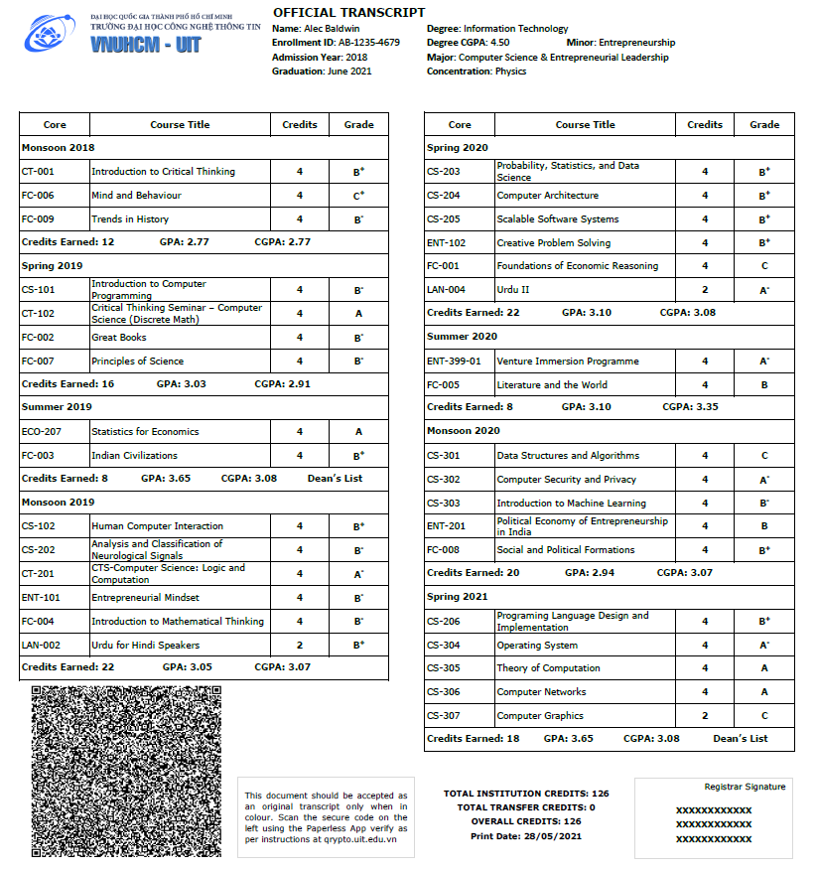
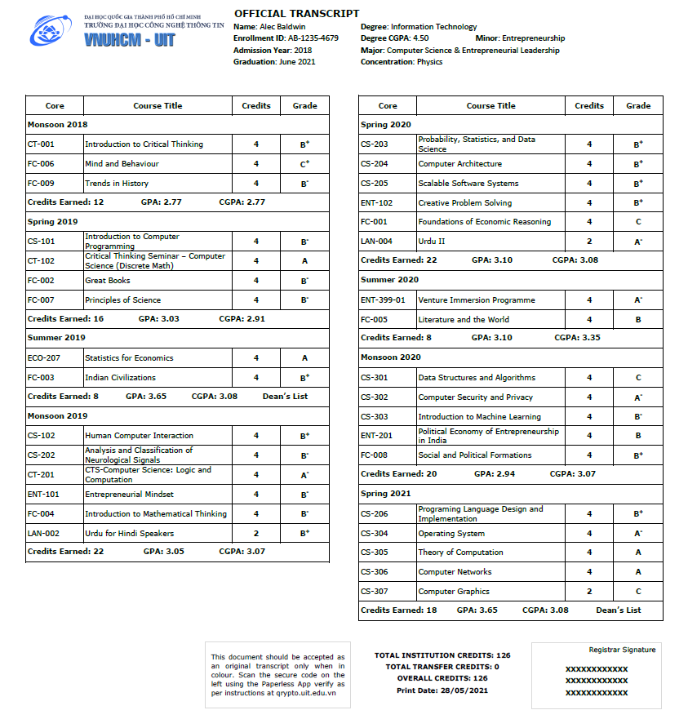
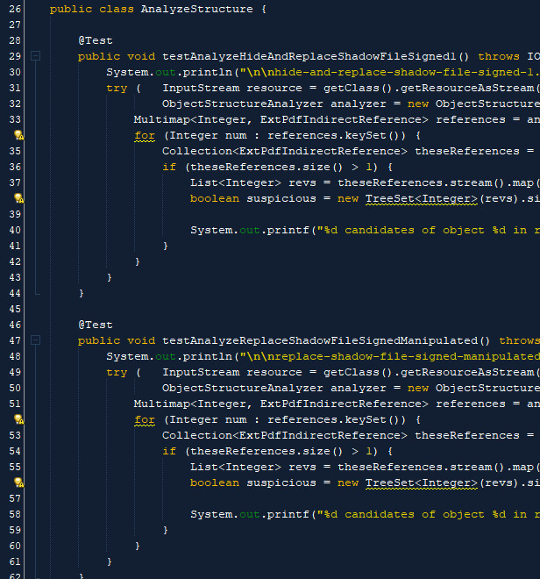

SOLUTION & VERIFICATION EXPERIENCE
Response
Variable Data from Student Information System
QRYPTO
Issuer
Template with Variable table support
Request
Background

Slide 18

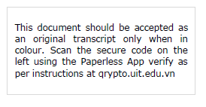
SOLUTION & VERIFICATION EXPERIENCE
Text next to the Qrypto Secure Code Guides the first time user to install the authorized App to instantly validate

Slide 19
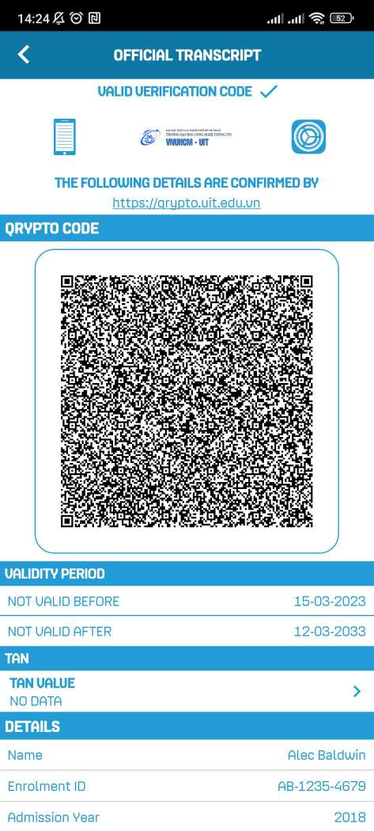
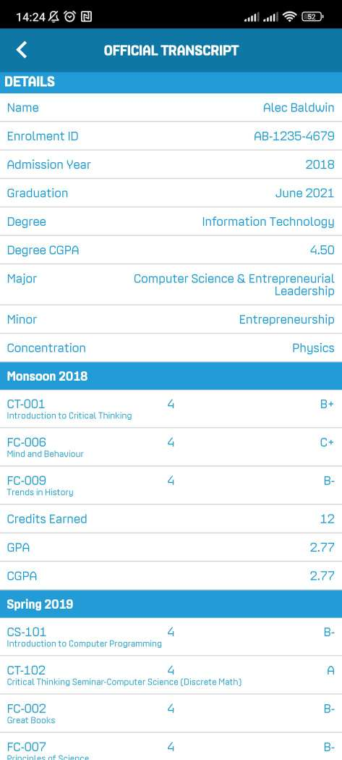
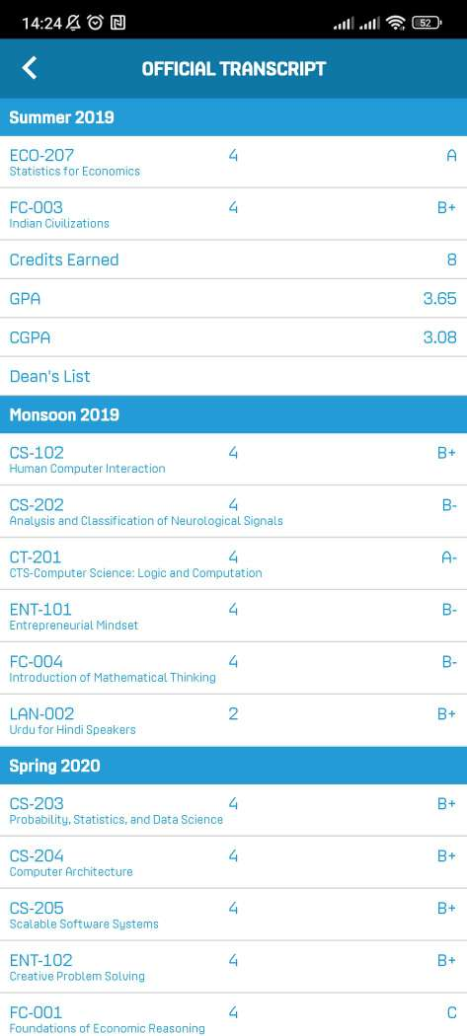
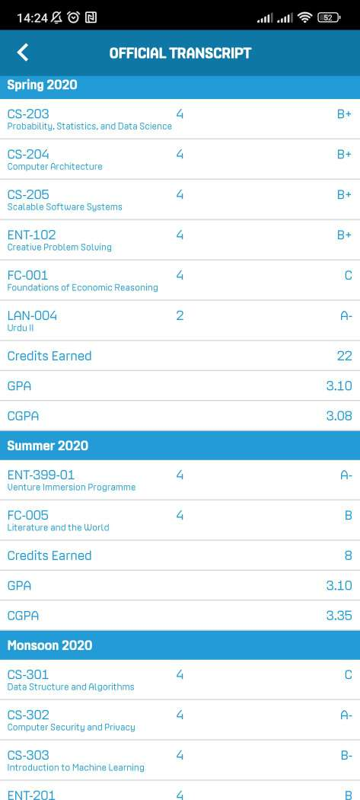

SOLUTION & VERIFICATION EXPERIENCE
Ultra secure: PKI based, equivalent to up-to 3072 bit
Compression: Qrypto Multi-Stage Pipeline Compression
Privacy: QR + Algorithm + Public Key provides access to data
Scanning the code with the Validator App enables validation of all the transcript details with automatic verification of digital signature of the University embedded inside the code. Anyone tampering the code will make it unverifiable
No need to share database, securely share via QR only

Slide 20

Involved a one-time integration and configuring templates
After integration, an API call with relevant information is sent from the Student Information System and the finished document is returned
Used for both transcripts and the degree certificates and for both the electronic and printed versions of the certificates
Provides a comprehensive solution to programmatically generate a fully finished PDF (having the secure QR code) as per University’s templates with both dynamic variable data and static information
Helps them to secure the entire transcript information in the form of a secure QR Code sealed with the University’s private key
SOLUTION SUMMARY

Slide 21




Thanks for watching!
MOBILE-ID TECHNOLOGIES & SERVICES JOINT STOCK COMPANY
19 Dang Tien Dong street, An Phu ward, Thu Duc City, Ho Chi Minh City
028 3636 6015
info@mobile-id.vn

